Slide 1
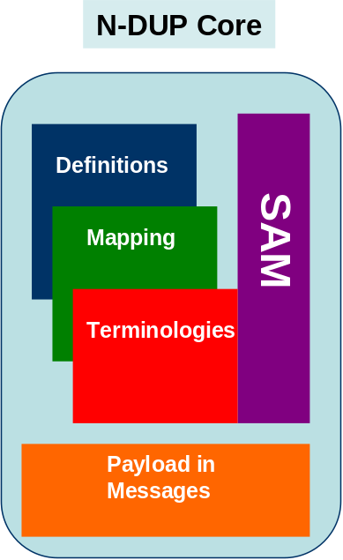
HL7 2.4
CDA
ISO 13606

Slide 2
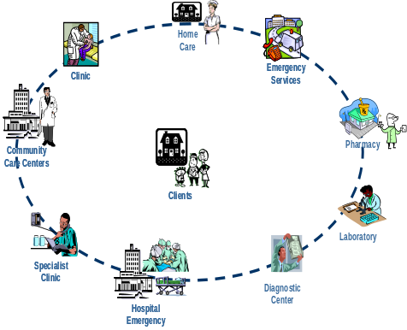
EHR
Public
Health
EU
NCP
HL7 2.4
CDA
ISO 13606

